Slide 1
Project 159, Group 4 Stock Market Data Analysis
Identifying Purchasing and Selling patterns by carefully analyzing the data to help the investors
Mentor – Mr. Karthik Muskula
Starting date: 04/10/2022
Members:
Aditi Mishra
Amrut Hugar
Dimple Klair
Dipak Khamkar
Mayur Ramtekkar
Vaibhavi Taide

Slide 2
Business objective and Problem:
Stock analysis is also called equity analysis or market analysis. Investors or traders make buying or selling decisions based on stock analysis information.
We basically determine the future activity of a market.
Our main objective is to help the investors to invest by identifying selling and purchasing patterns using data analytics.
Whenever we analyze a dataset recorded over a time interval, we will do Time Series Analysis. The time interval of a time series data can be weekly, monthly, daily, or even hourly time intervals, but the process of analyzing our data will remain the same in most of the problems.
Risk factor is there:- Before entering into a trade, a trader needs to know how much risk they can take for the reward they are expecting from the stock.

Slide 3
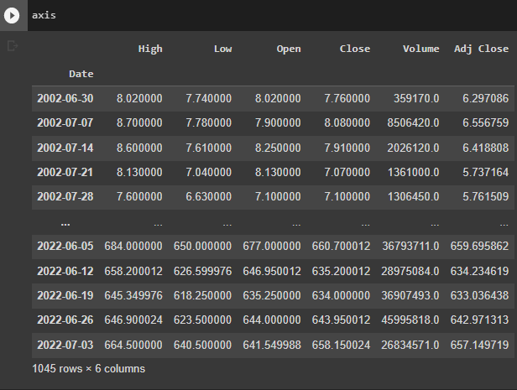
Data Scraping
4 stocks; Axis Bank, HDFC Bank, ICICI Bank, Indusland Bank.
Fetched data from 05/07/2002 for the next 20 years, having a interval of 1 week or say frequency.
Data of each bank stock contains 6 columns
And having values for 1045 dates, which is 1 week apart from each other

Slide 4
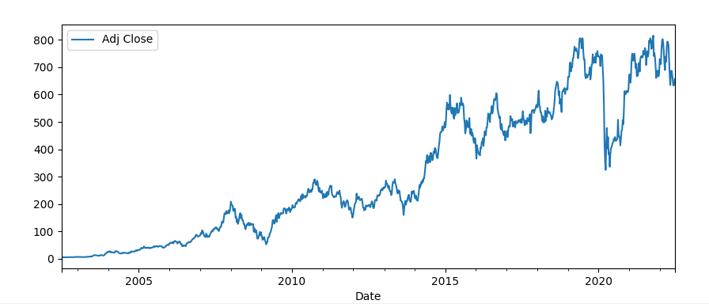
Exploratory Data Analysis
Historical view of the Adjusted Closing price of Axis Bank
This graph shows Adj Close price vs Date for Axis Bank Data

Slide 5
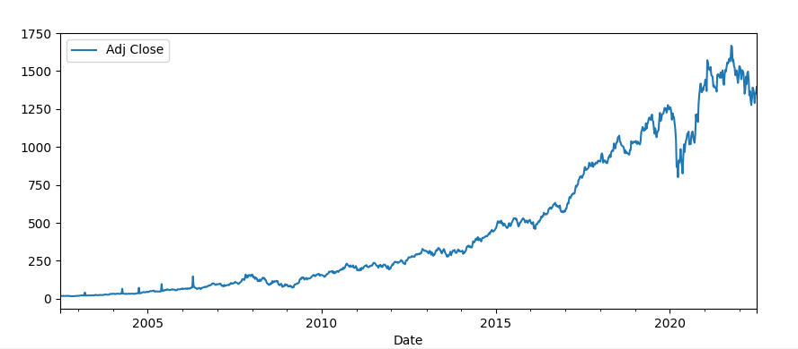
Exploratory Data Analysis
Historical view of the Adjusted Closing price of HDFC Bank
This graph shows Adj Close price vs Date for HDFC Bank Data

Slide 6
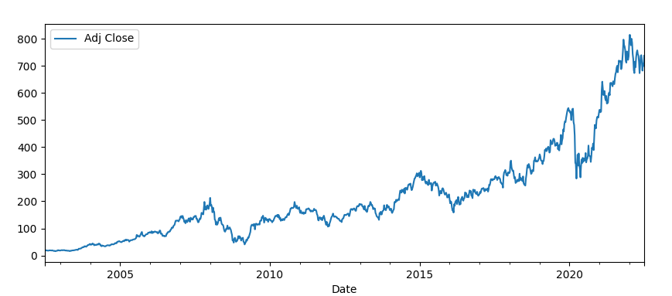
Exploratory Data Analysis
Historical view of the Adjusted Closing price of ICICI Bank
This graph shows Adj Close price vs Date for ICICI Bank Data

Slide 7
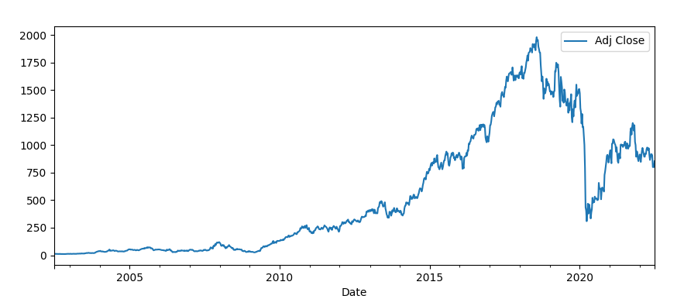
Exploratory Data Analysis
Historical view of the Adjusted Closing price of Indusland Bank
This graph shows Adj Close price vs Date for Indusland Bank Data

Slide 8
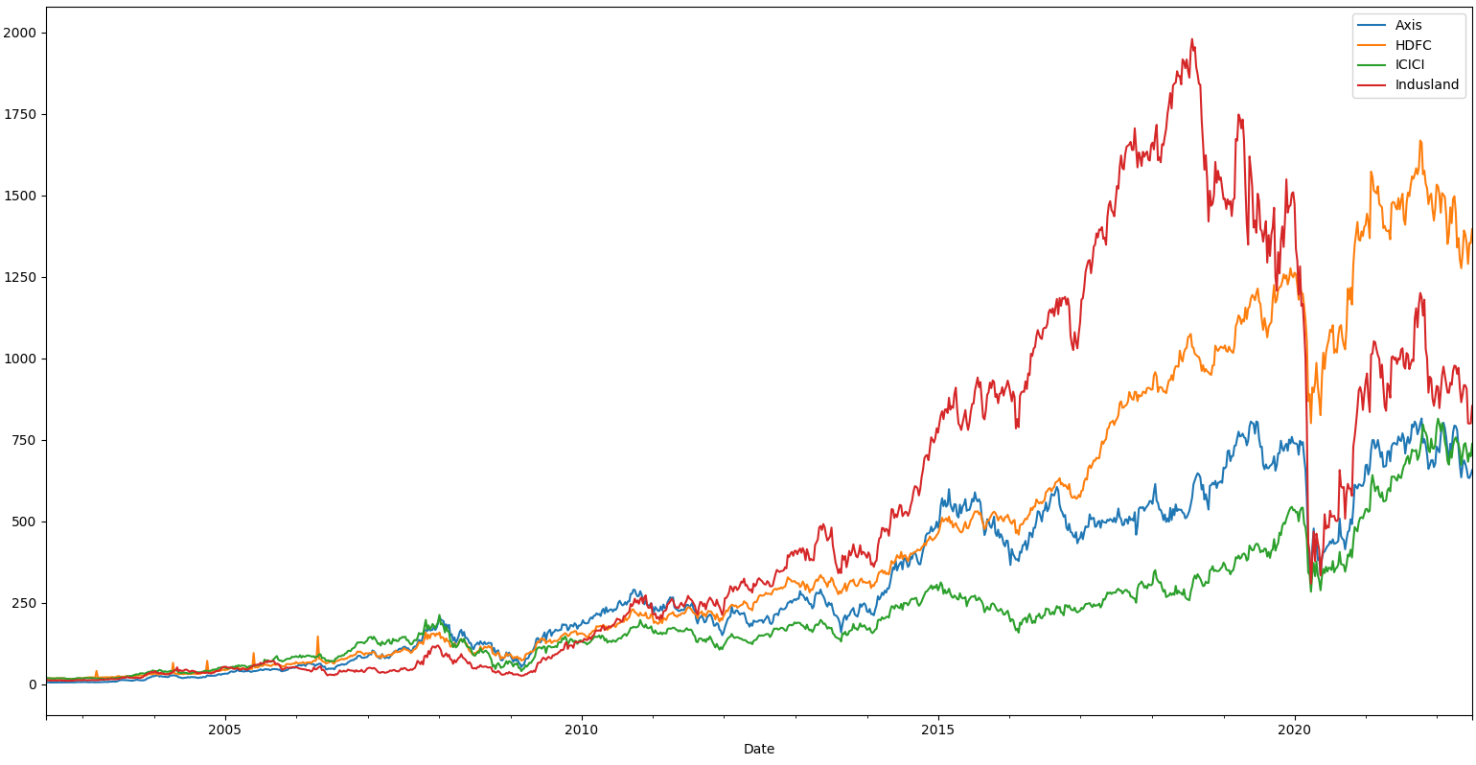
Exploratory Data Analysis
Comparison of Closing Prices of all stocks
In this graph we can clearly see that Indusland bank had a peek in its closing price in 2019 and suddenly dropped in 2020.
On the other hand HDFC bank has been performing consistently well when compared to others

Slide 9
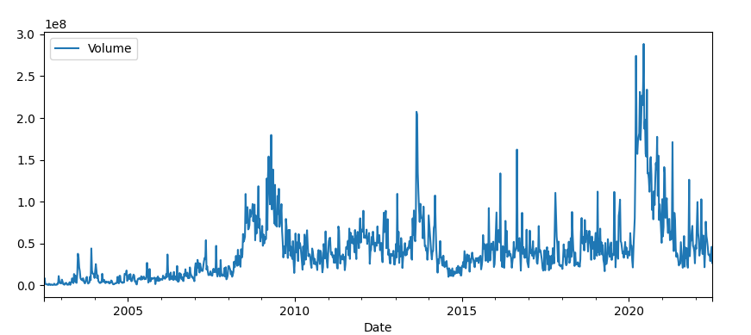
Exploratory Data Analysis
Total Volume of Axis Bank stocks being traded from 2002 to 2022

Slide 10
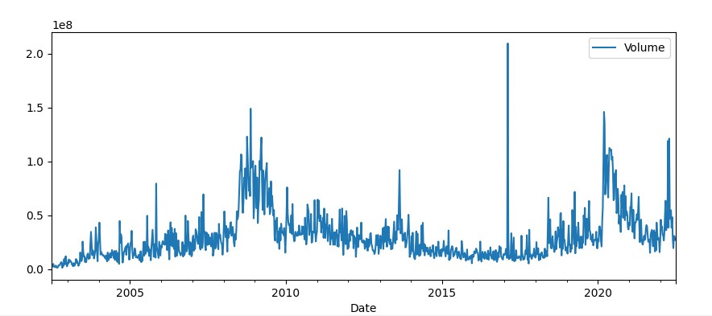
Exploratory Data Analysis
Total Volume of HDFC Bank stocks being traded from 2002 to 2022

Slide 11
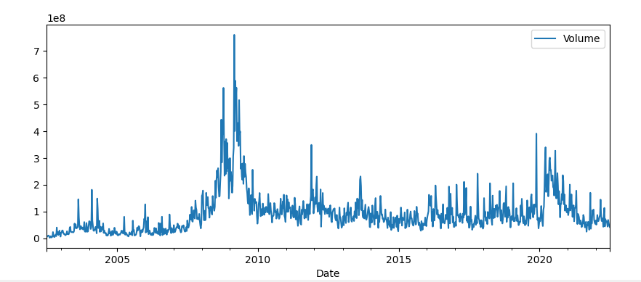
Exploratory Data Analysis
Total Volume of ICICI Bank stocks being traded from 2002 to 2022

Slide 12
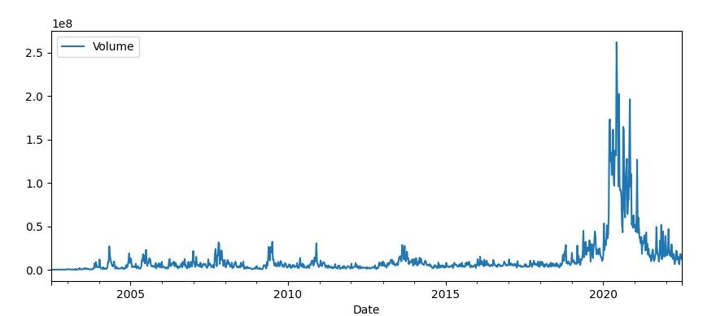
Exploratory Data Analysis
Total Volume of Indusland Bank stocks being traded from 2002 to 2022

Slide 13
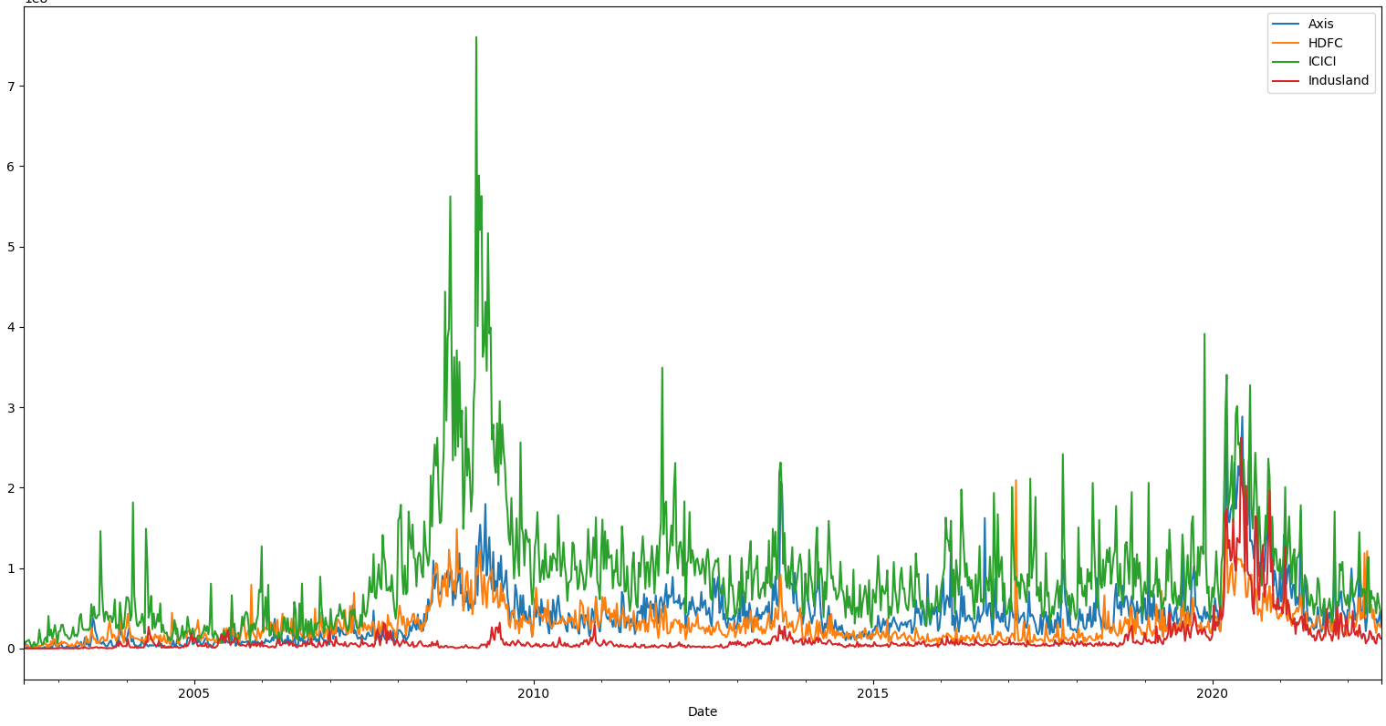
Exploratory Data Analysis
Comparison of all stock’s Volumes
Here we can see that ICICI bank has higher number of shares of security traded between its daily open and close.
Indusland has lower volume compared to others.

Slide 14
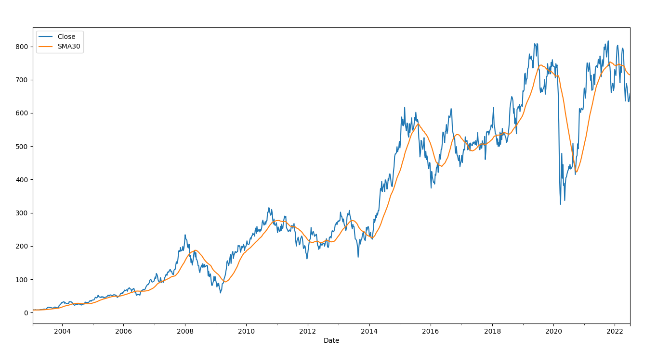
Moving Averages for Axis Bank
SMA
It shows simple moving average for 30 days which is not that close to actual data

Slide 15
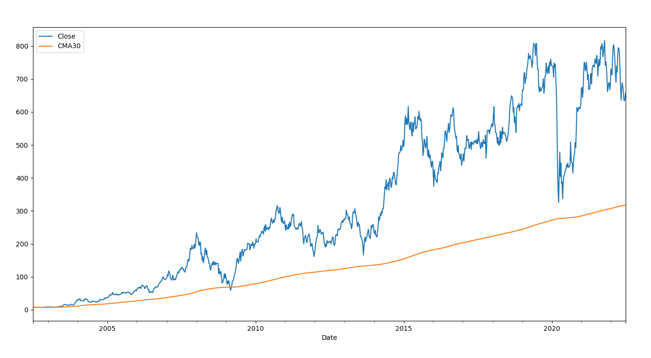
Moving Averages for Axis Bank
CMA

Slide 16
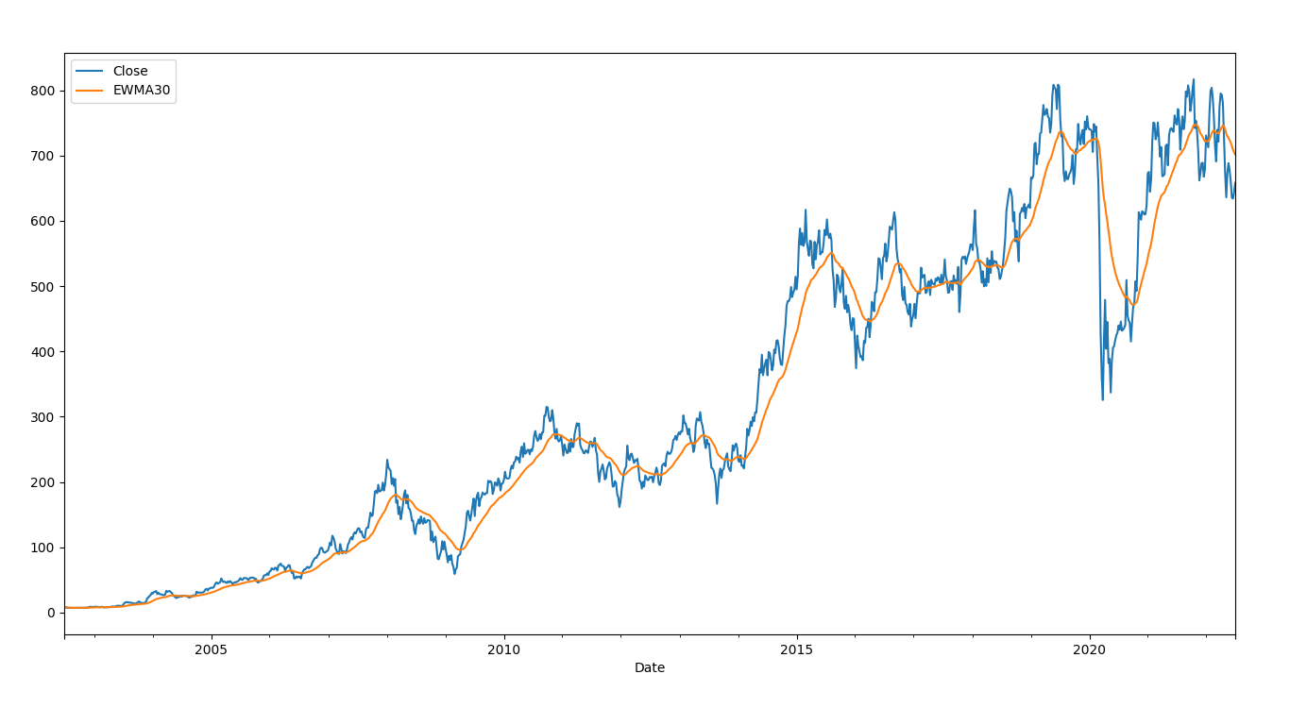
Moving Averages for Axis Bank
EMA
It shows exponential moving average for 30 days which is slightly close to actual data

Slide 17
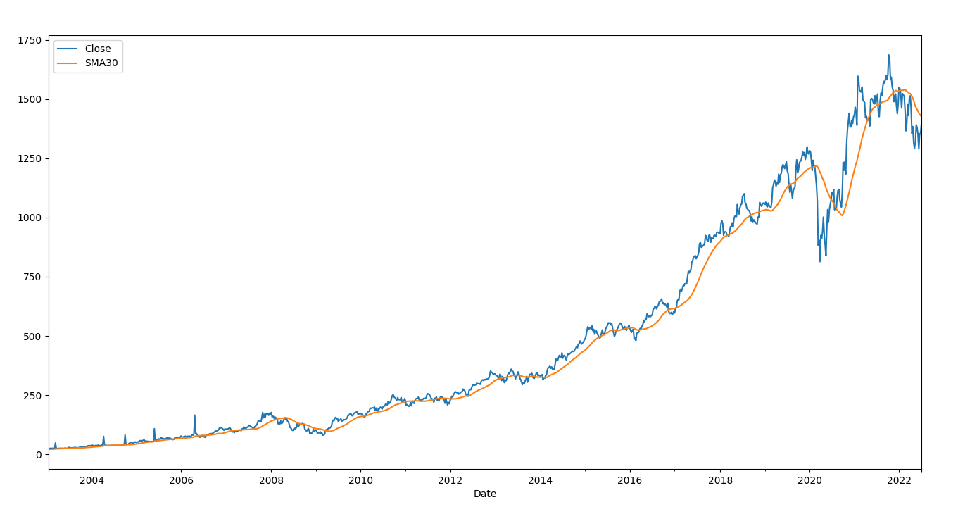
Moving Averages for HDFC Bank
SMA
It shows simple moving average for 30 days which is not that close to actual data

Slide 18
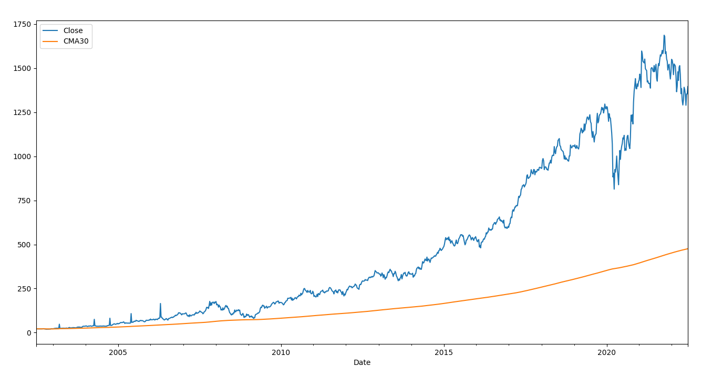
Moving Averages for HDFC Bank
CMA

Slide 19
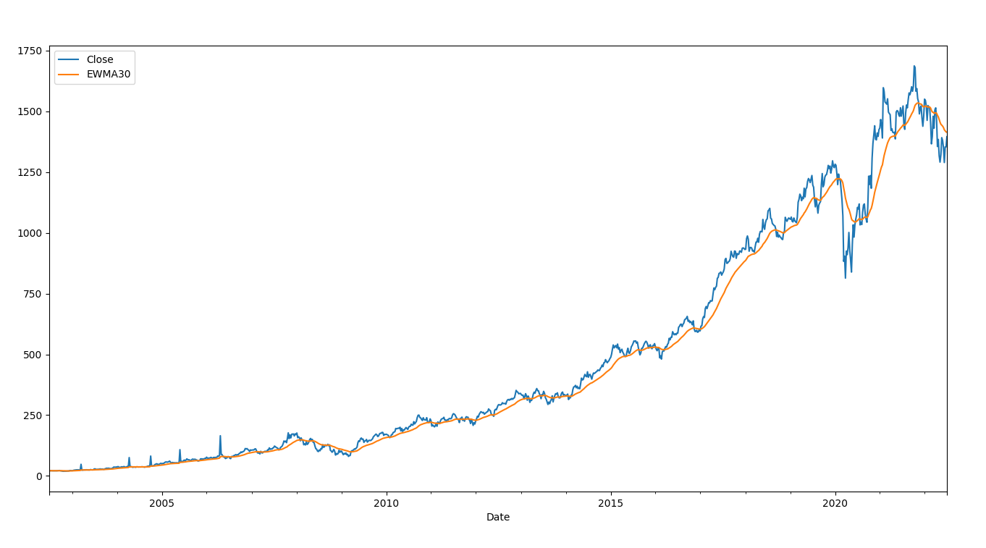
Moving Averages for HDFC Bank
EMA
It shows exponential moving average for 30 days which is slightlyclose to actual data

Slide 20
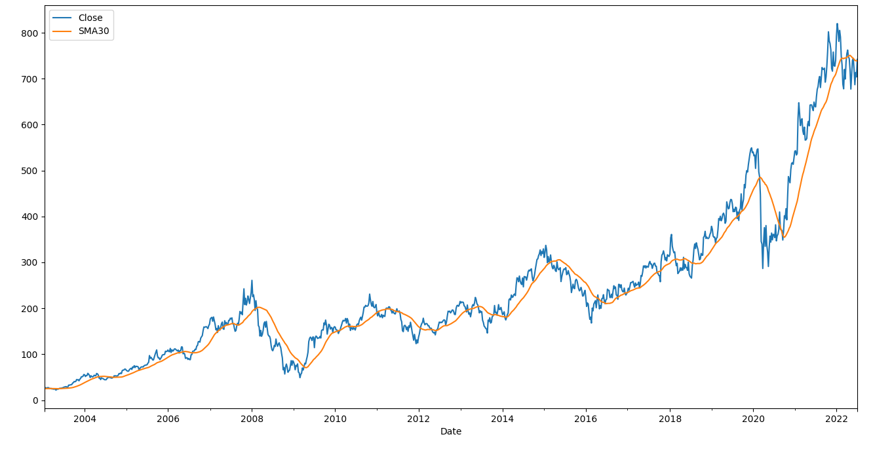
Moving Averages for ICICI Bank
SMA
It shows simple moving average for 30 days which is not that close to actual data

Slide 21
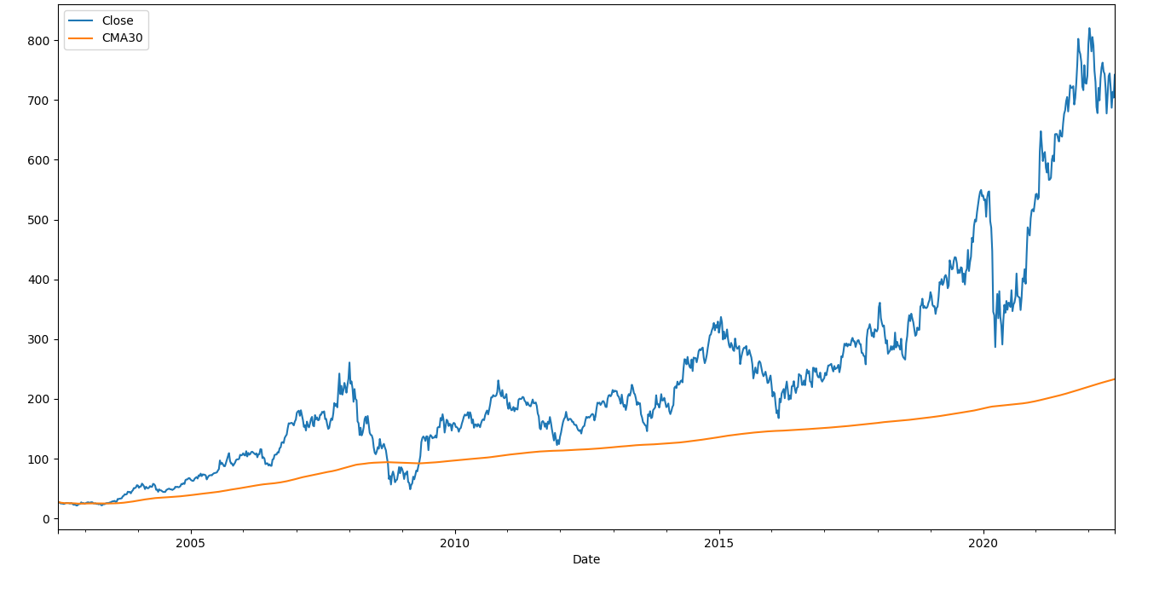
Moving Averages for ICICI Bank
CMA

Slide 22
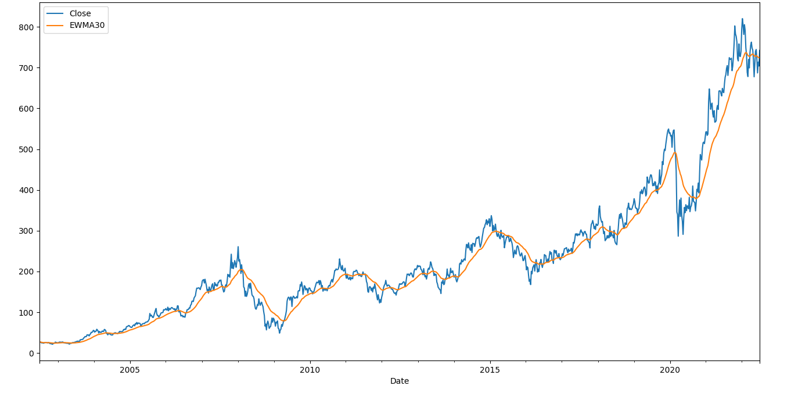
Moving Averages for ICICI Bank
EMA
It shows exponential moving average for 30 days which is slightly close to actual data

Slide 23
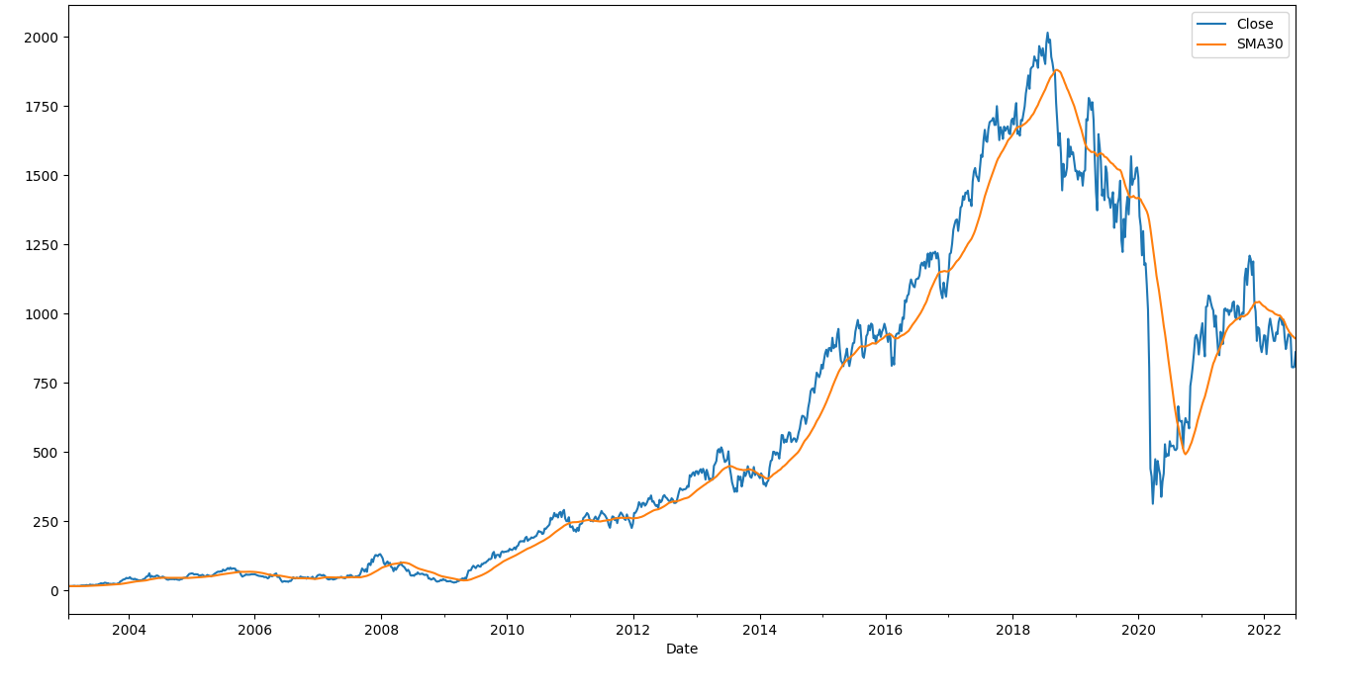
Moving Averages for Indusland Bank
SMA
It shows simple moving average for 30 days which is not that close to actual data

Slide 24
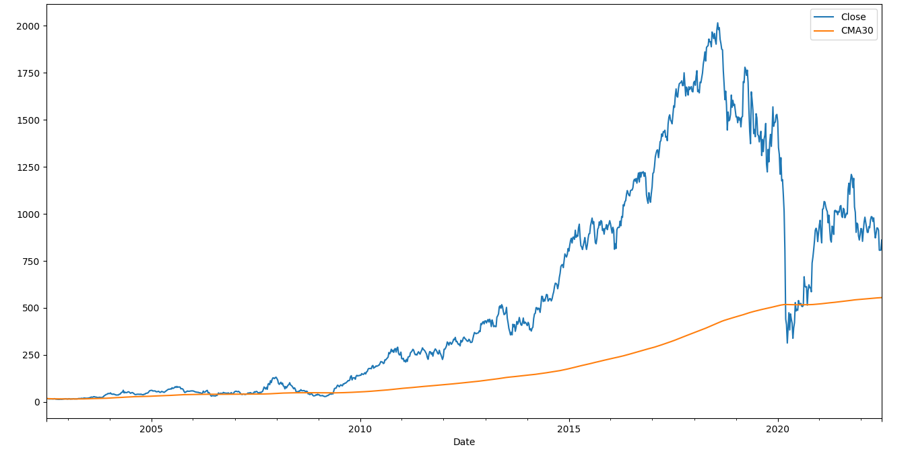
Moving Averages for Indusland Bank
CMA

Slide 25
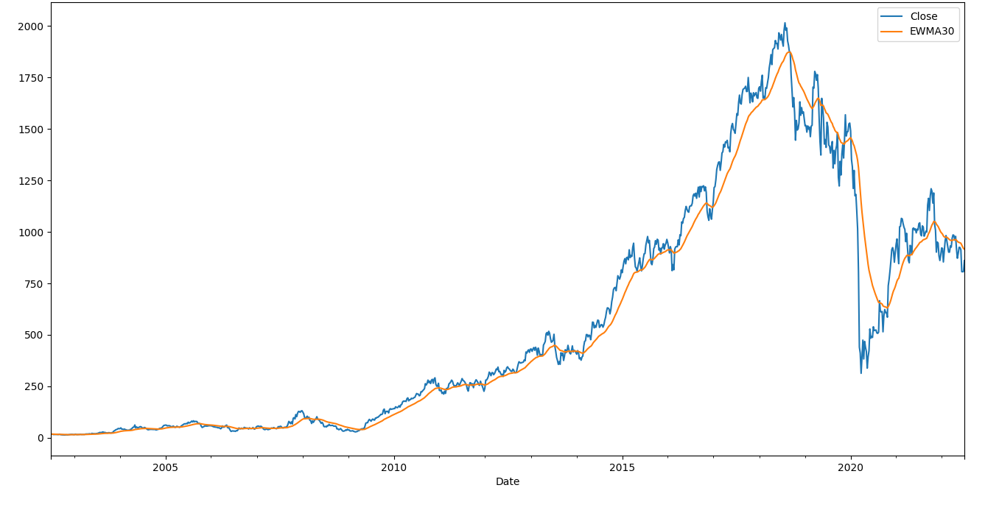
Moving Averages for Indusland Bank
EMA
It shows exponential moving average for 30 days which is slightly close to actual data

Slide 26
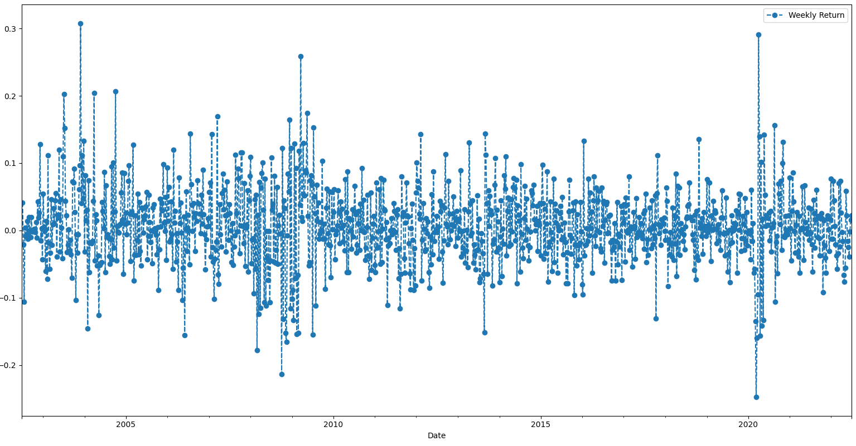
Weekly Returns
Weekly Returns of Axis Bank

Slide 27
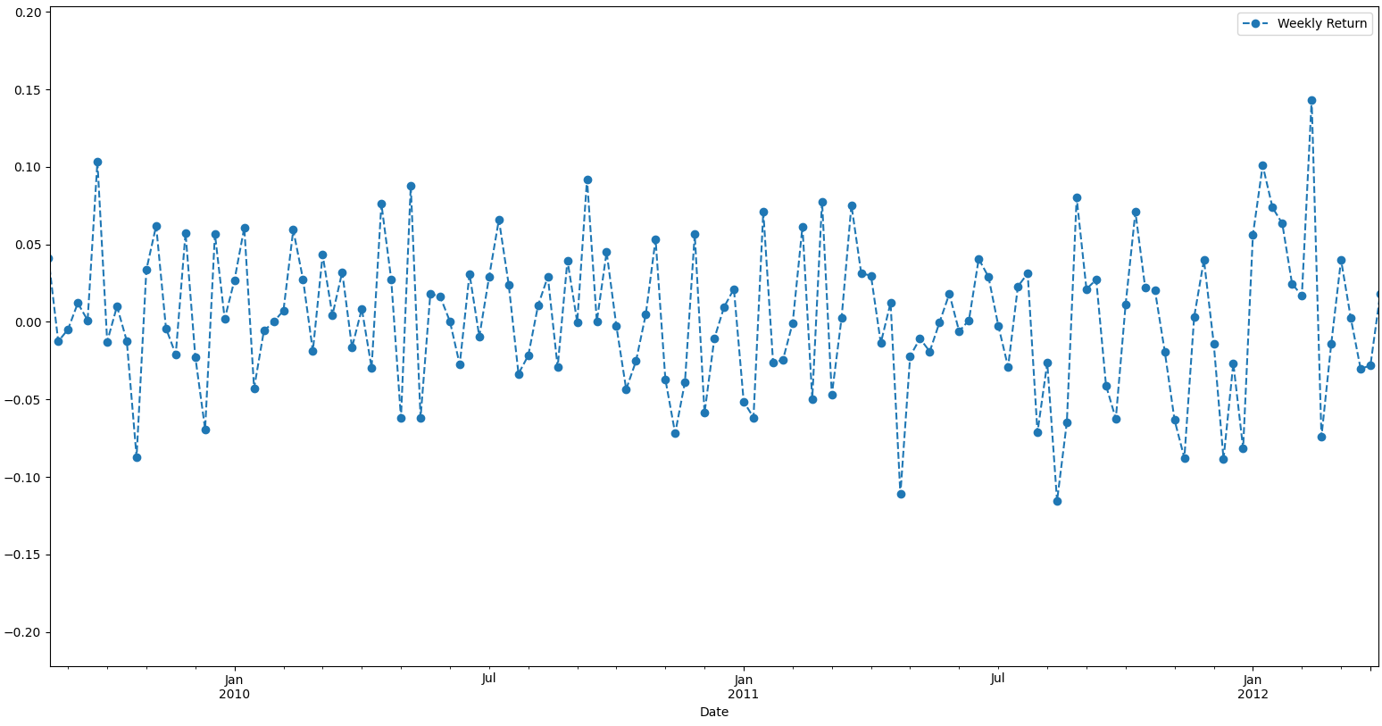
Weekly Returns
Lets have a closer look at weekly returns of Axis Bank

Slide 28
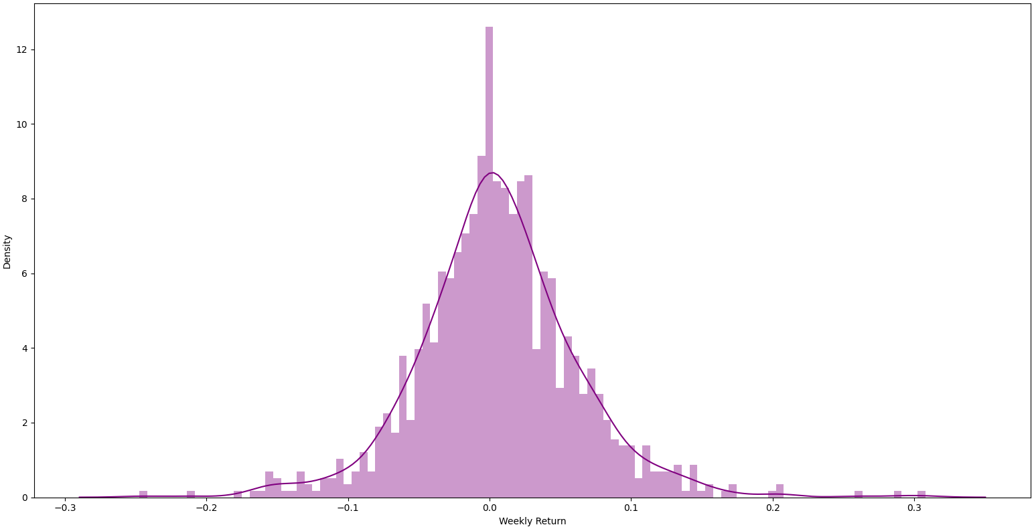
Weekly Returns
Overall Average Weekly Returns of Axis Bank

Slide 29
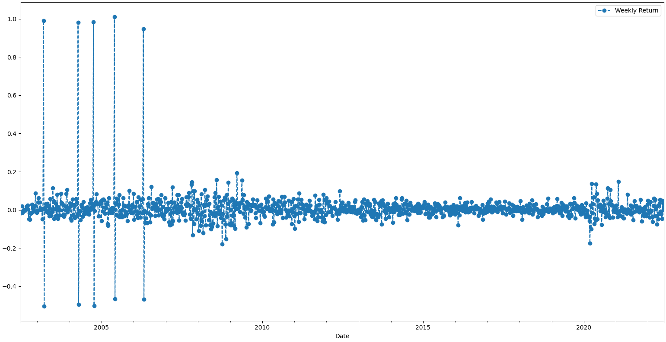
Weekly Returns
Weekly Returns for HDFC Bank

Slide 30
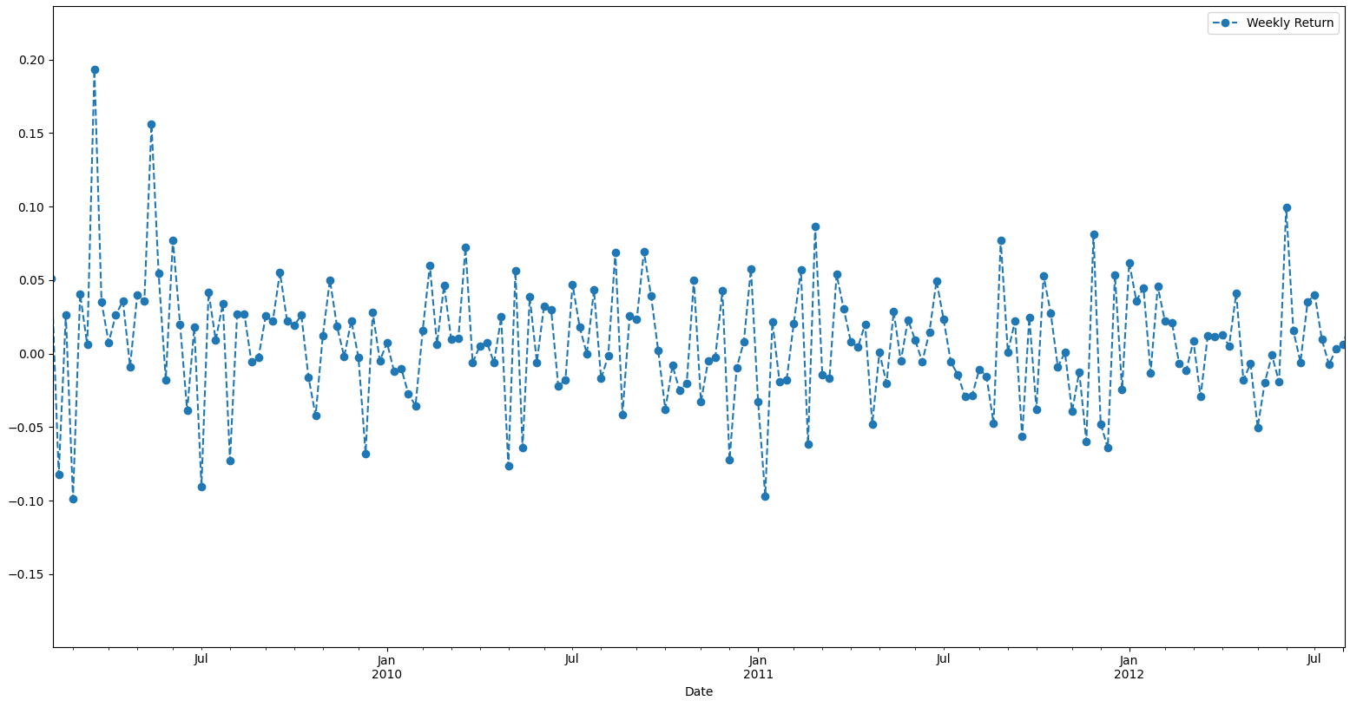
Weekly Returns
Lets have a closer look at weekly returns of HDFC Bank

Slide 31
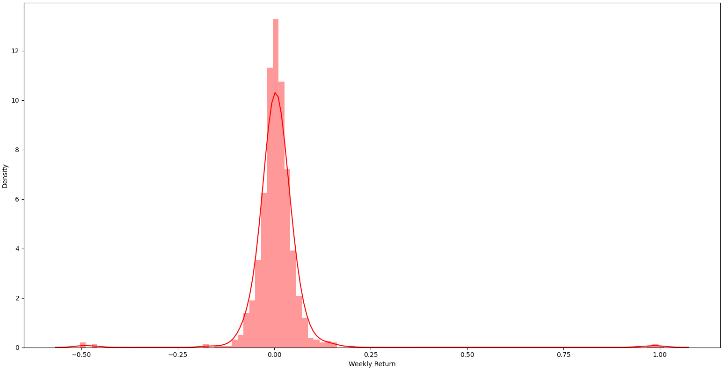
Weekly Returns
Overall Average Weekly Returns of HDFC Bank

Slide 32
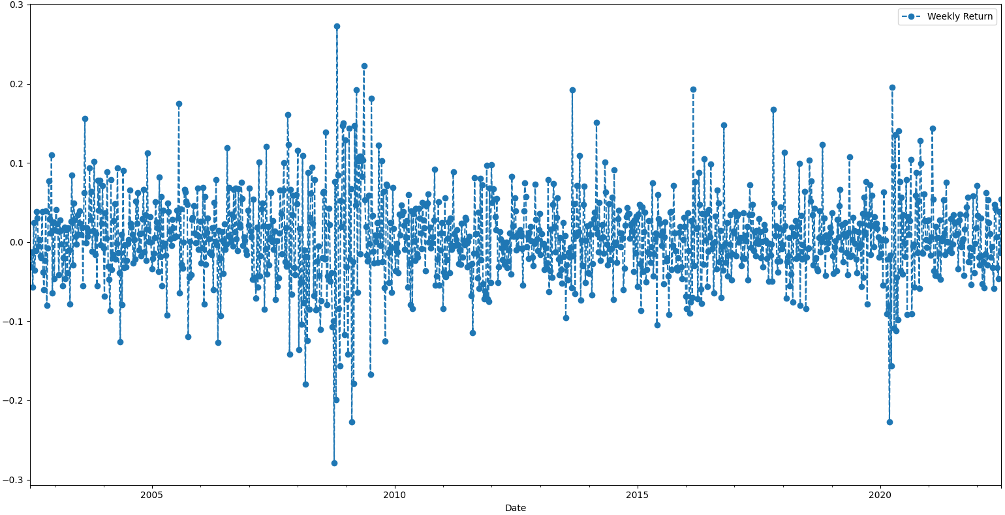
Weekly Returns
Weekly Returns for ICICI Bank

Slide 33
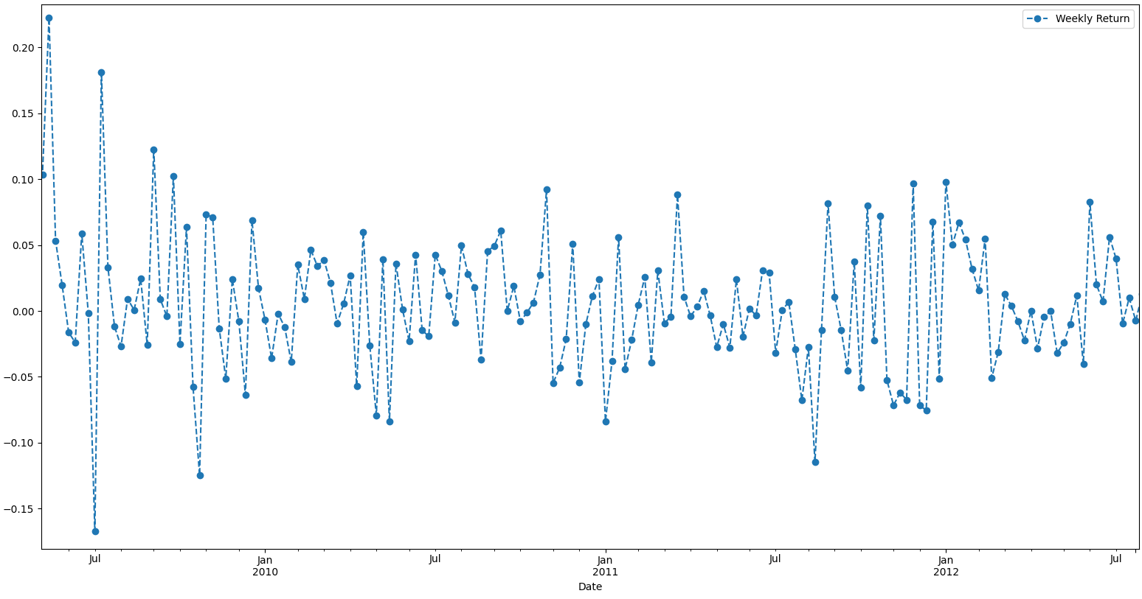
Weekly Returns
Lets have a closer look at weekly returns of ICICI Bank

Slide 34
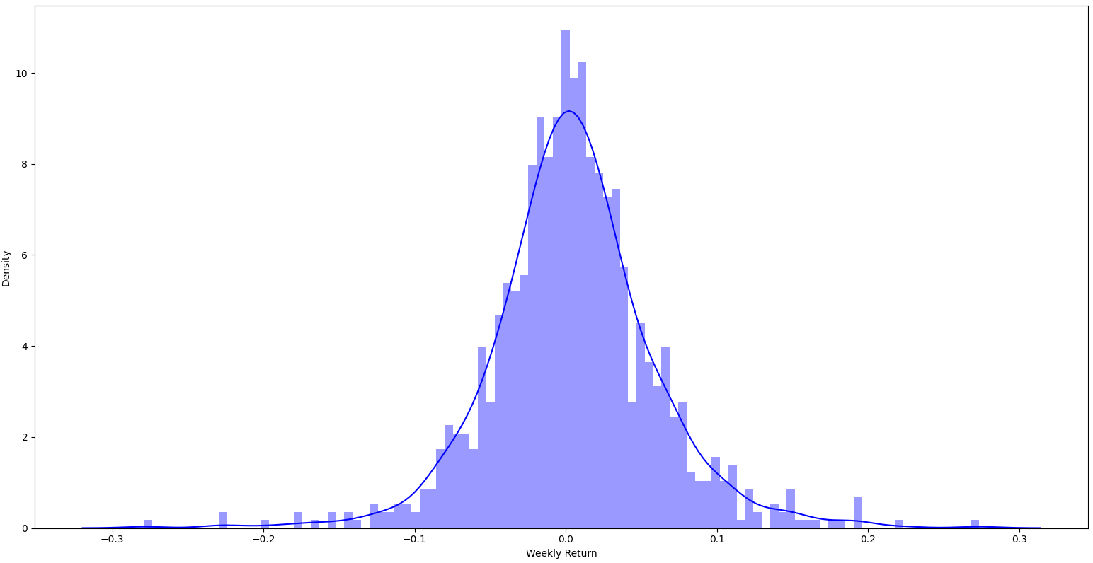
Weekly Returns
Overall Average Weekly Returns of ICICI Bank

Slide 35
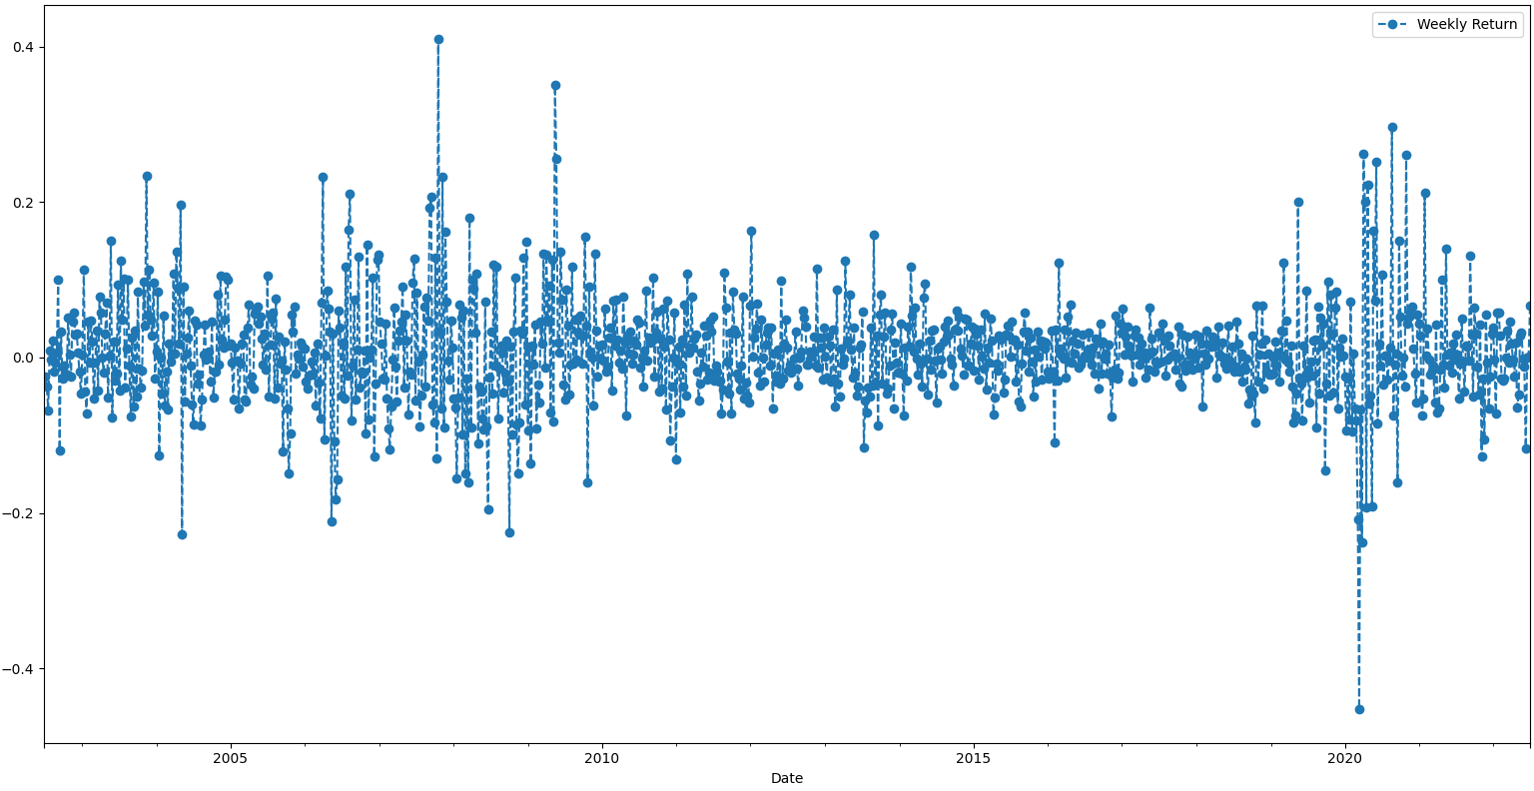
Weekly Returns
Weekly Returns for Indusland Bank

Slide 36
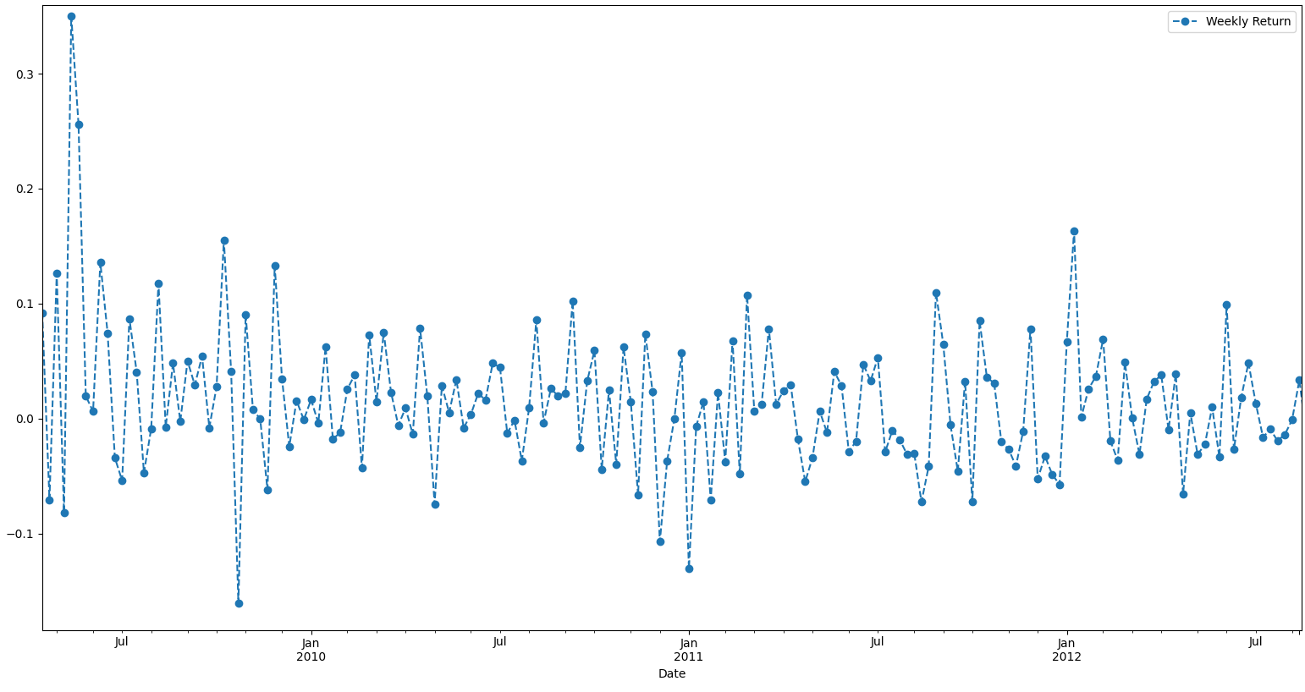
Weekly Returns
Lets have a closer look at weekly returns of ICICI Bank

Slide 37
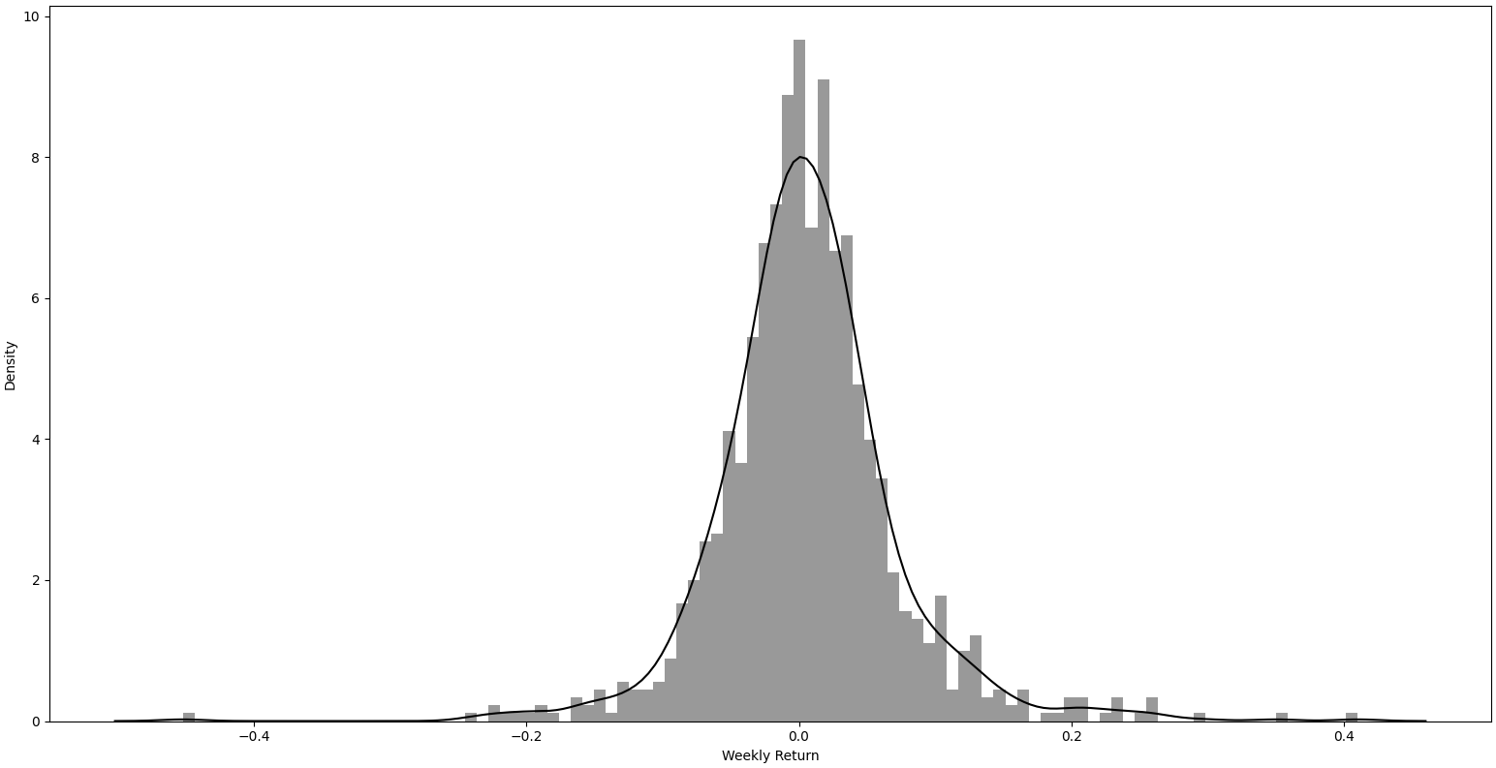
Weekly Returns
Overall Average Weekly Returns of Indusland Bank

Slide 38
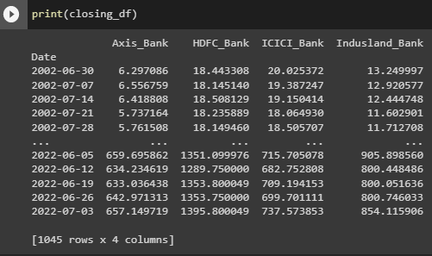
Returns of all 4 stocks
Adjusted Closing prices of all 4 stocks

Slide 39
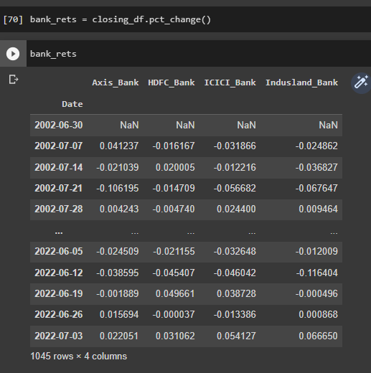
Returns of all 4 stocks
Percent Change values in the previous dataframe.

Slide 40
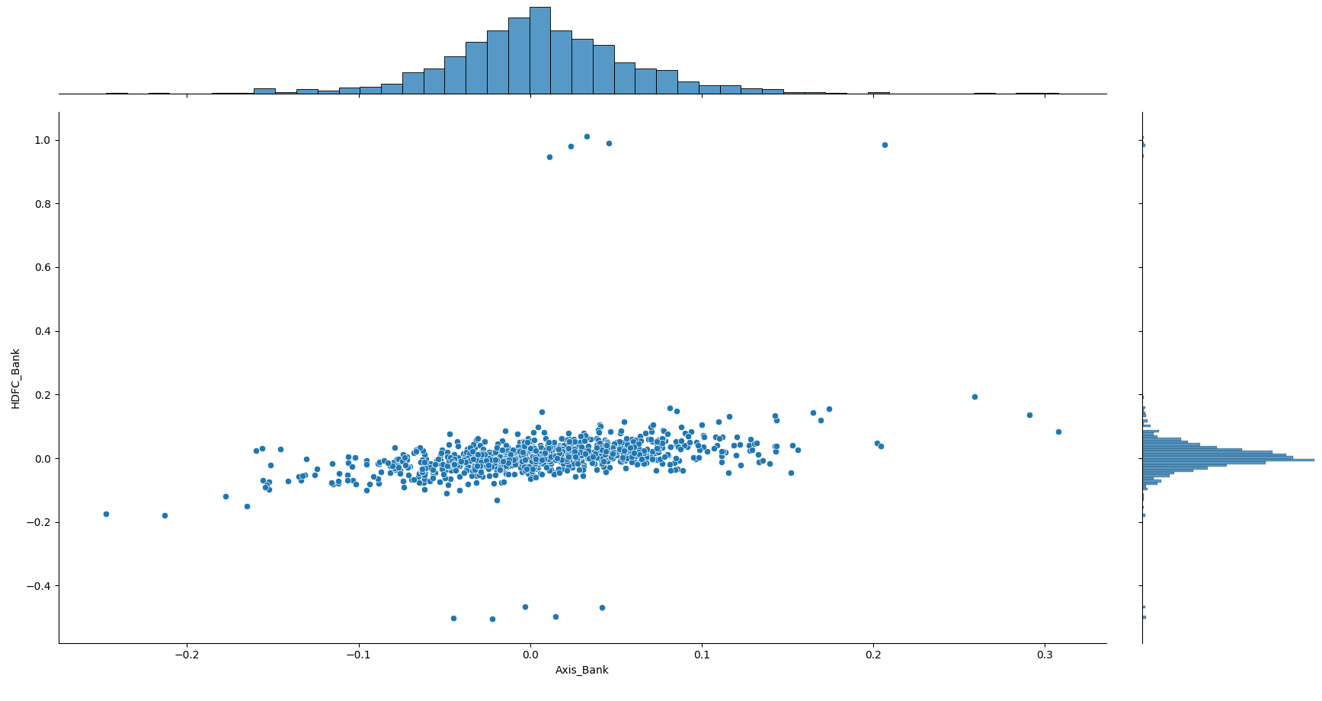
Comparing Weekly Returns
Comparing weekly returns of Axis Bank and HDFC Bank

Slide 41
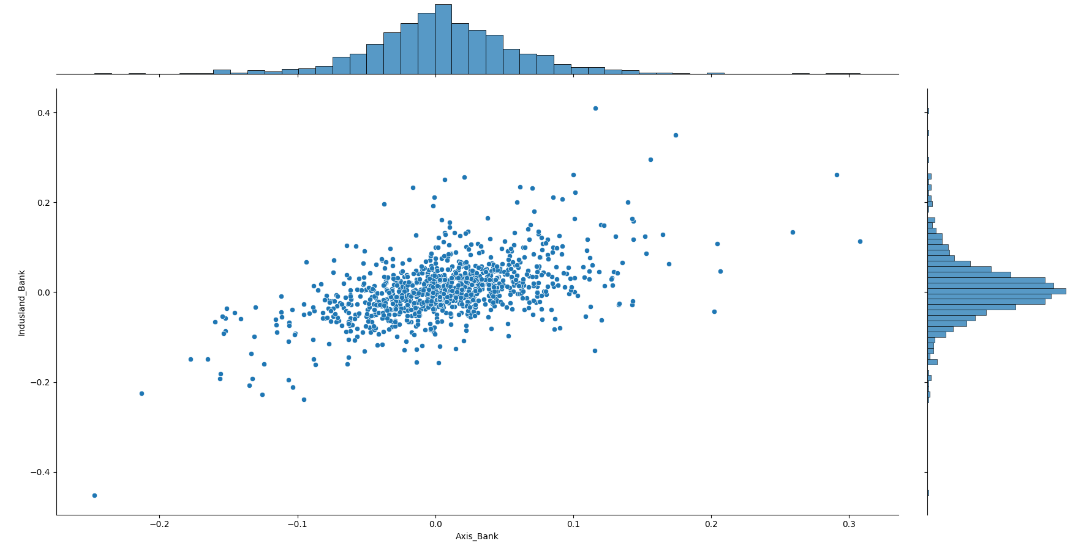
Comparing Weekly Returns
Comparing weekly returns of Axis Bank and HDFC Bank

Slide 42
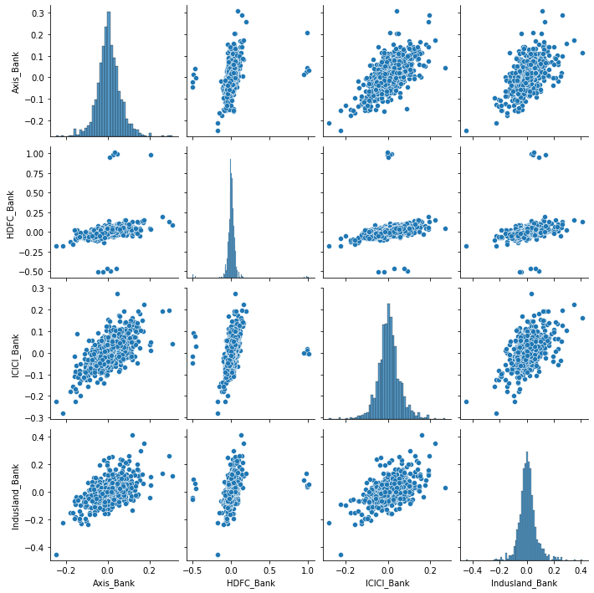
Comparing Weekly Returns
Automatic visual analysis of all percent changed Adjusted Close price and the comparisons.

Slide 43
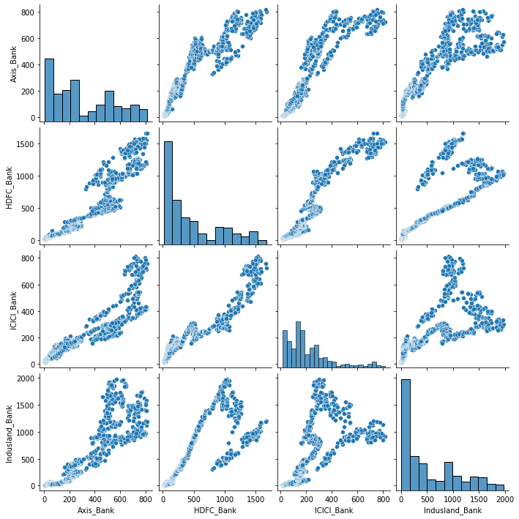
Comparing Weekly Returns
Automatic visual analysis of all the actual Adjusted Close price and the comparisons.

Slide 44
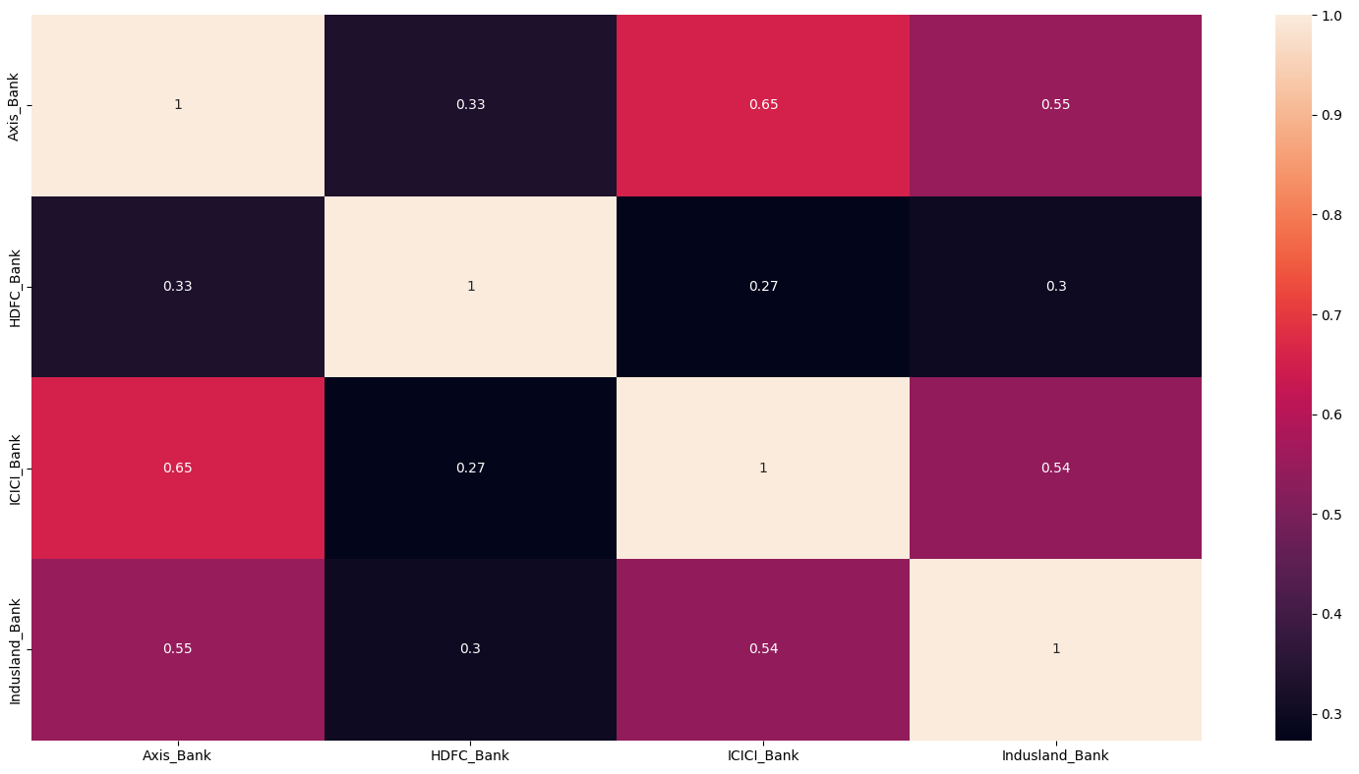
Comparing Weekly Returns
Heatmap of percent changed Adjusted Close price

Slide 45
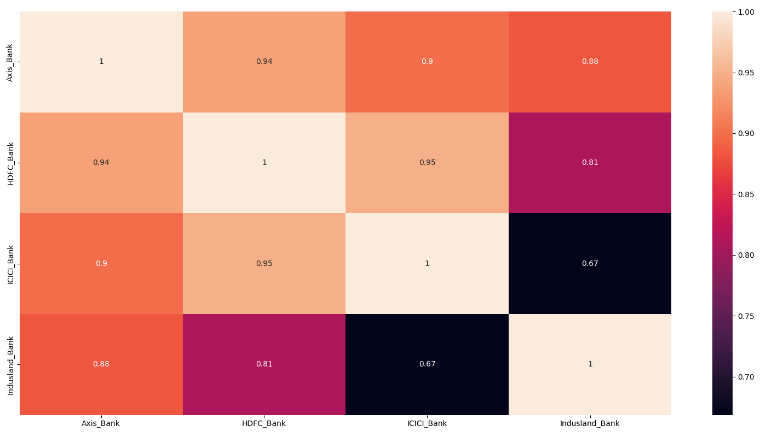
Comparing Weekly Returns
Heatmap of actual Adjusted Close price.

Slide 46
Model Building

Slide 47

Different Forecasting Models used are as follows:
LSTM (Long Short Term Memory)
Prophet
ARIMA (Autoregressive integrated moving average)
Moving Average
KNN (K-Nearest Neighbor)

Slide 48
Long Short Term Memory:
RMSE scores of different stocks for LSTM Model:
LSTM networks are well-suited to classifying, processing and making predictions based on time series data, since there can be lags of unknown duration between important events in a time series.
Stocks | RMSE
HDFC | 50.2948
AXIS | 7.9960
ICICI | 9.0893
INDUSLAND | 27.2161

Slide 49
Prophet:
Prophet is a procedure for forecasting time series data based on an additive model where non-linear trends are fit with yearly, weekly, and daily seasonality, plus holiday effects. It works best with time series that have strong seasonal effects and several seasons of historical data.
RMSE scores of different stocks for Prophet Model:
Stocks | RMSE
HDFC | 9.9952
AXIS | 12.2230
ICICI | 9.0586
INDUSLAND | 14.2028

Slide 50
ARIMA:
ARIMA, short for ‘Auto Regressive Integrated Moving Average’ is actually a class of models that ‘explains’ a given time series based on its own past values, that is, its own lags and the lagged forecast errors, so that equation can be used to forecast future values.
RMSE scores of different stocks for Arima Model:
Stocks | RMSE
HDFC | 753.6205
AXIS | 884.719
ICICI | 651.7687
INDUSLAND | 562.489

Slide 51
Moving Average:
In time series analysis, the moving-average model (MA model), also known as moving-average process, is a common approach for modeling univariate time series. The moving-average model specifies that the output variable is cross-correlated with a non-identical to itself random-variable.
RMSE scores of different stocks for Moving Average Model:
Stocks | RMSE
HDFC | 581.3808
AXIS | 168.8067
ICICI | 151.6071
INDUSLAND | 680.3568

Slide 52
KNN:
K-Nearest Neighbour algorithm stores all the available data and classifies a new data point based on the similarity. This means when new data appears then it can be easily classified into a well suite category by using K- NN algorithm.
RMSE scores of different stocks for KNN Model:
Stocks | RMSE
HDFC | 803.0618
AXIS | 265.2282
ICICI | 281.0384
INDUSLAND | 733.2419

Slide 53
Model Selection:
Model is selected based on their RMSE values.
Models with least RMSE for all the stocks are LSTM and Prophet.
Hence further deployment of models will be done using LSTM and Prophet Model

Slide 54
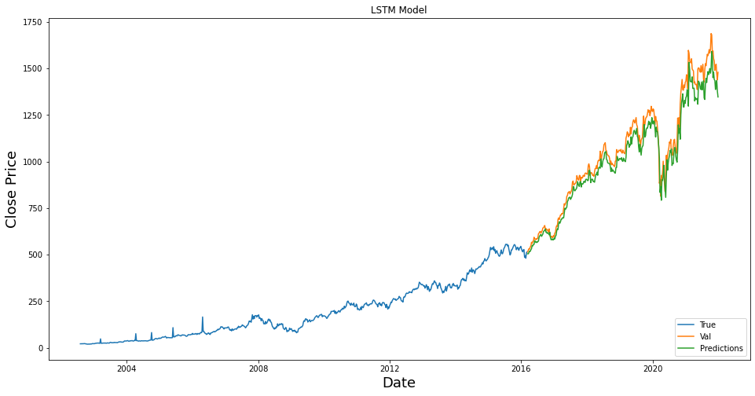
Forecasting using LSTM (HDFC):

Slide 55
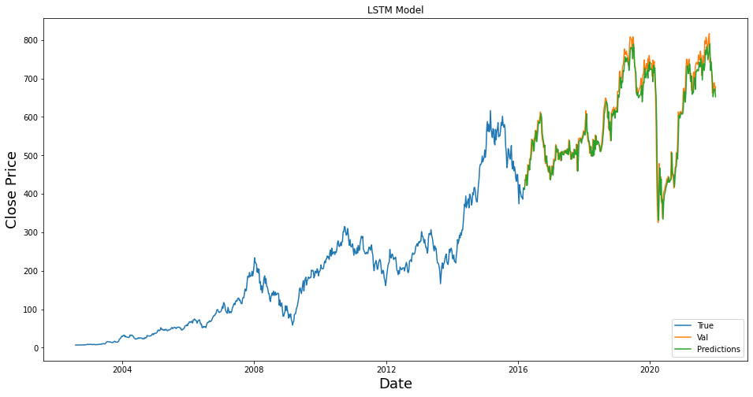
Forecasting using LSTM (AXIS):

Slide 56
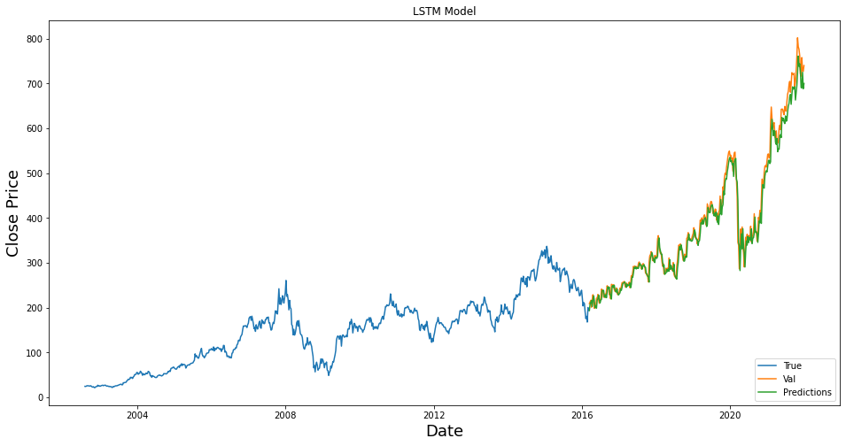
Forecasting using LSTM (ICICI):

Slide 57
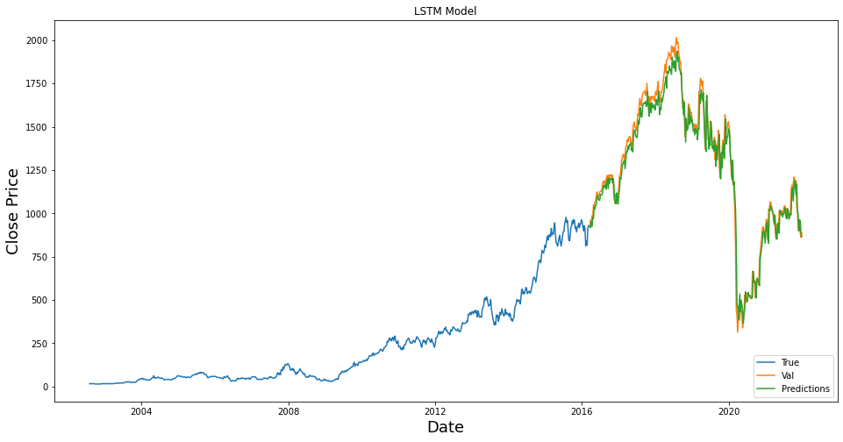
Forecasting using LSTM (INDUSLAND):

Slide 58
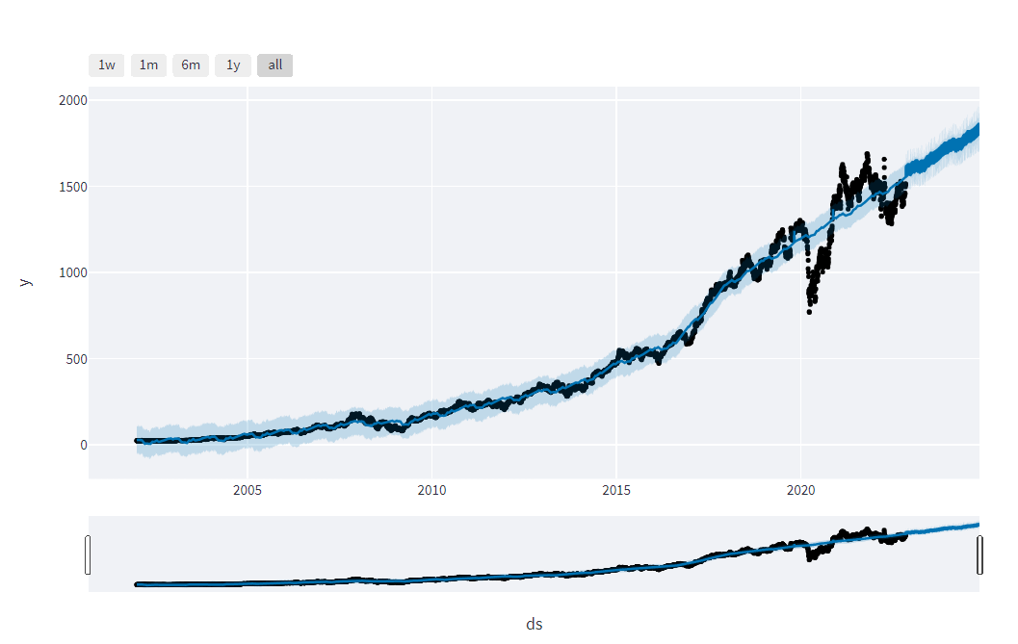
Forecasting using Prophet (HDFC):

Slide 59
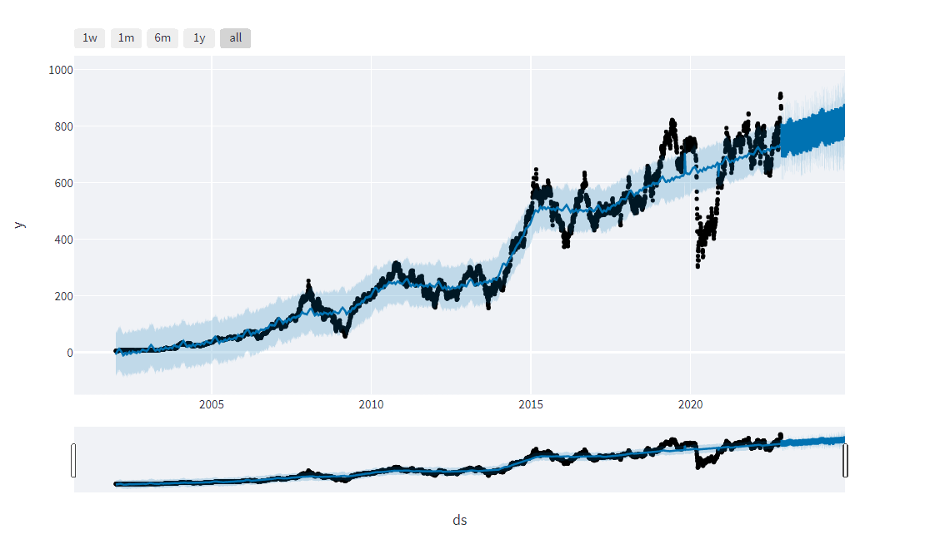
Forecasting using Prophet (AXIS):

Slide 60
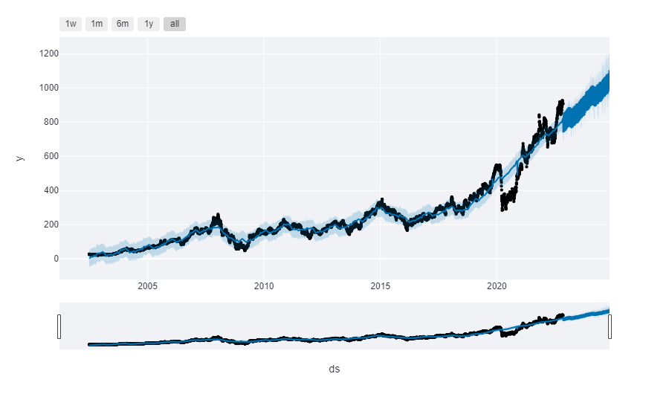
Forecasting using Prophet (ICICI):

Slide 61

Forecasting using Prophet (INDUSLAND):

Slide 62
Model Deployment

Slide 63
Model Deployment: Model is deployed using Streamlit, it is an open-source app framework for Machine Learning. For LSTM: http://localhost:8502/ For Prophet: http://localhost:8501/

Slide 64


Model Deployment using LSTM Model:

Slide 65


Slide 66


Slide 67


Model Deployment Using Prophet Model:

Slide 68



Slide 69


Slide 70
Challenges Faced:
Gathering the data
Model Building
Selecting best model
How to overcome?:
Data was collected using yahoo finance
Model Building was done using neural network models, time series based models
Best model was selected based upon their RMSE values. Models with least RMSE values are LSTM and Prophet.

Slide 71
Thank You

